Slide 1
Sets
Ed. 2. and 3.: Chapter 7
Ed. 4.: Chapter 8

Slide 2
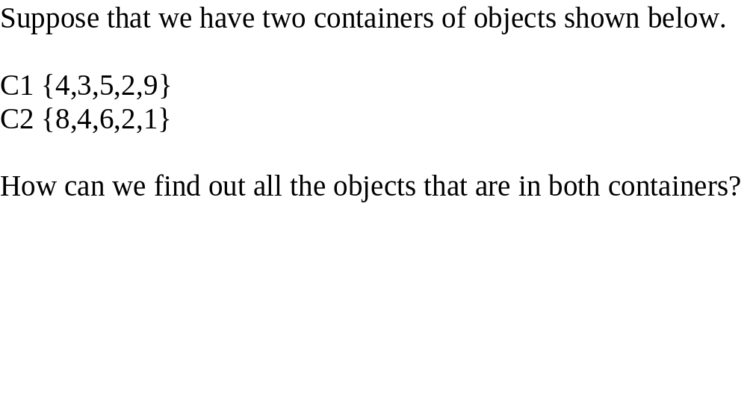
The Set Abstract Data Type

Slide 3
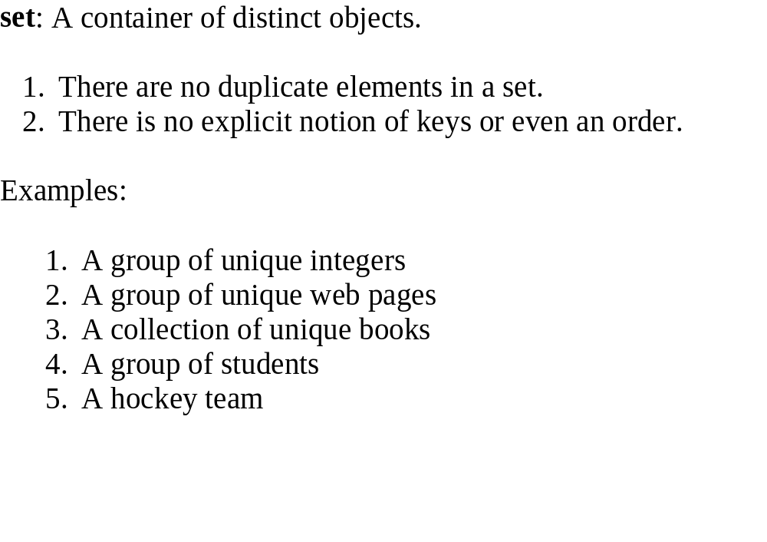

Slide 4
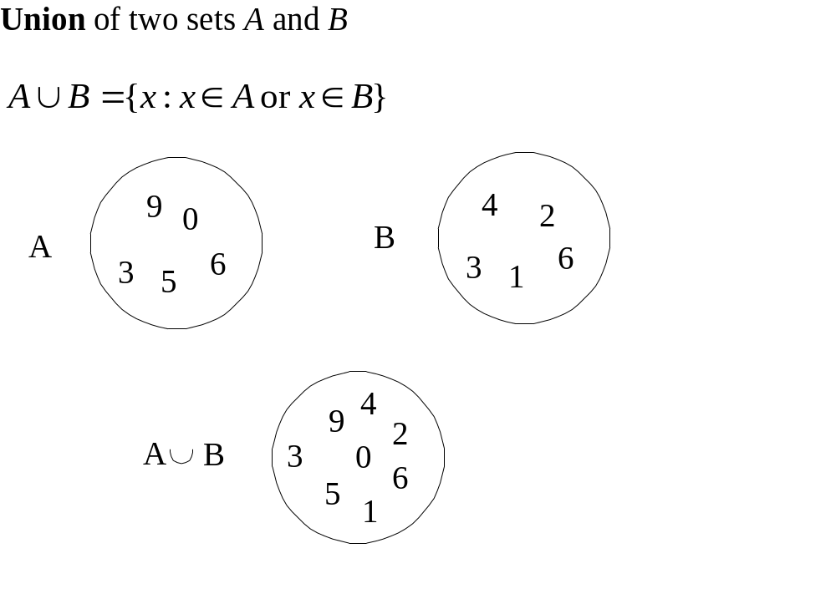

Slide 5
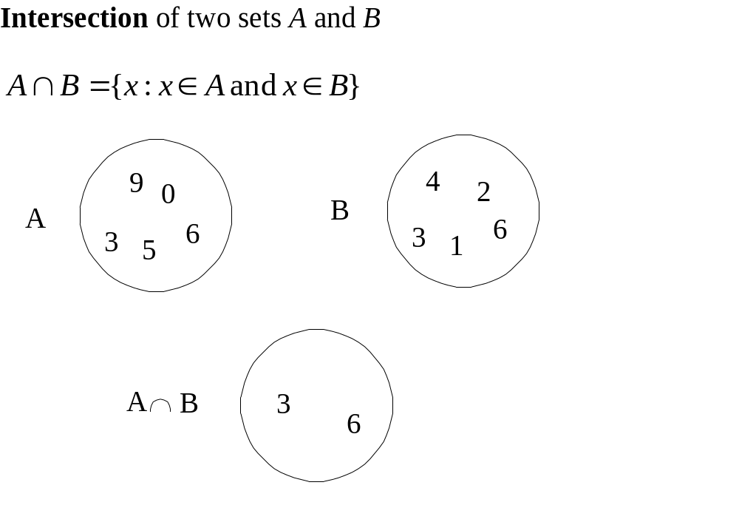

Slide 6
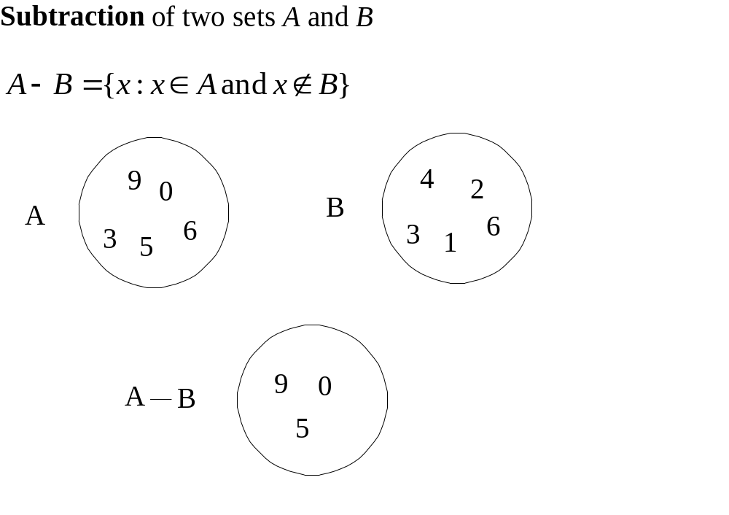

Slide 7
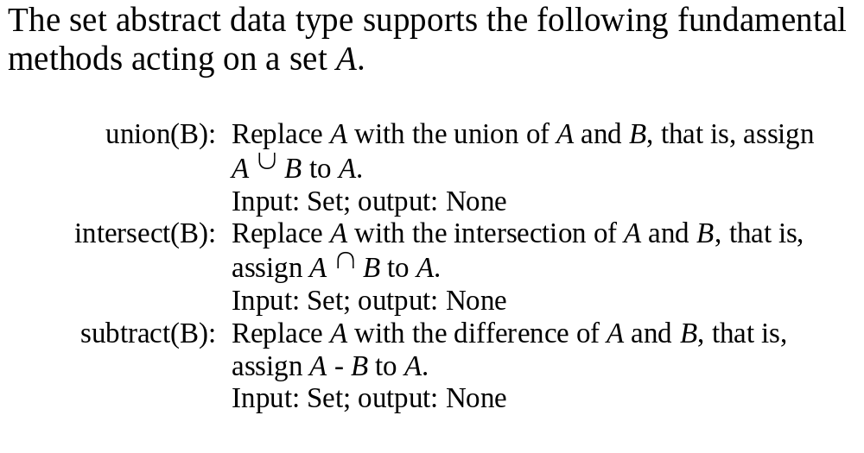
The Set Abstract Data Type

Slide 8
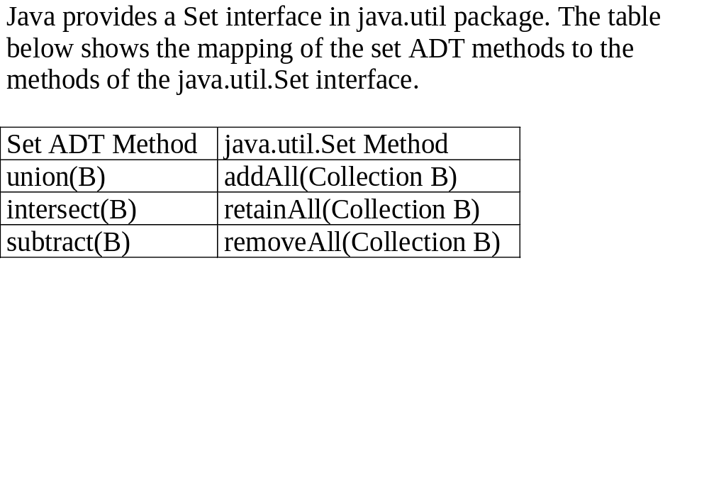

Slide 9
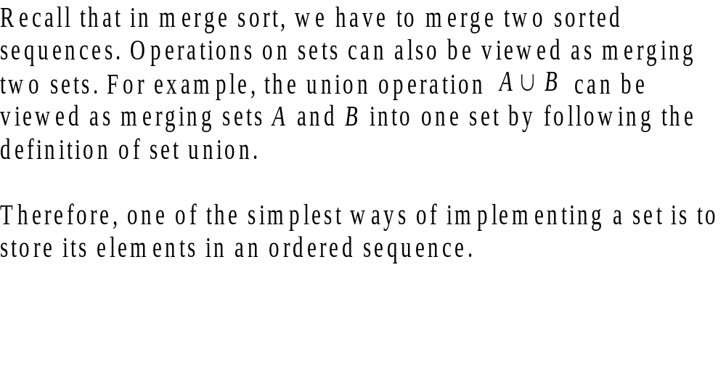
A Simple Set Implementation

Slide 10
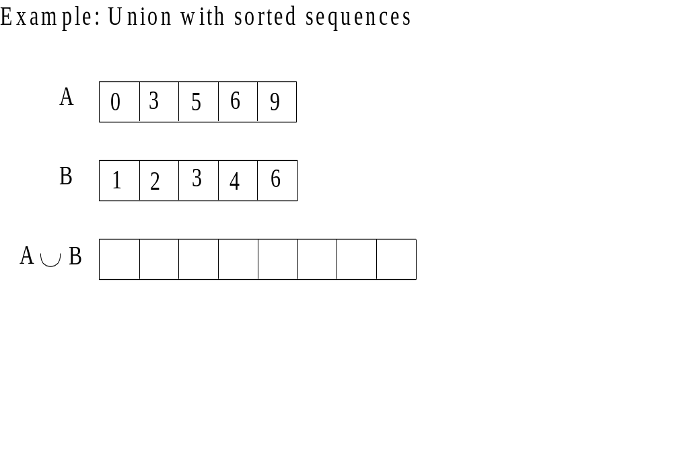

Slide 11
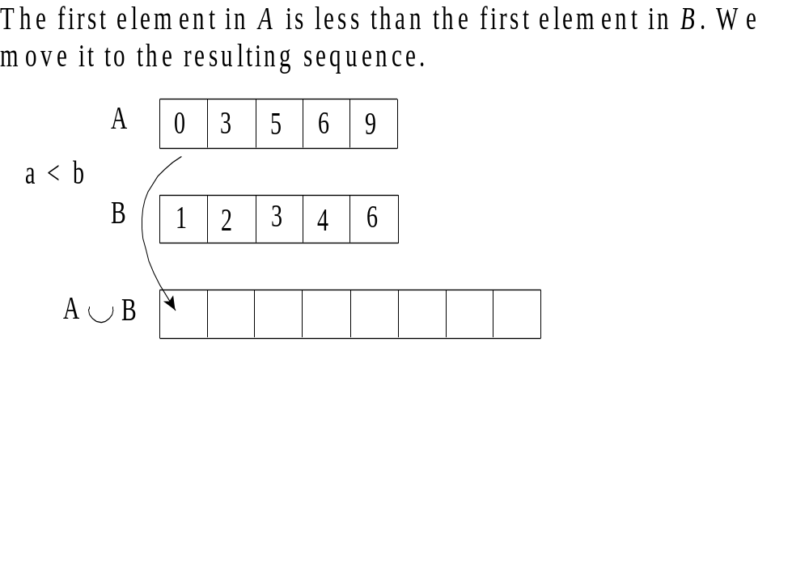

Slide 12
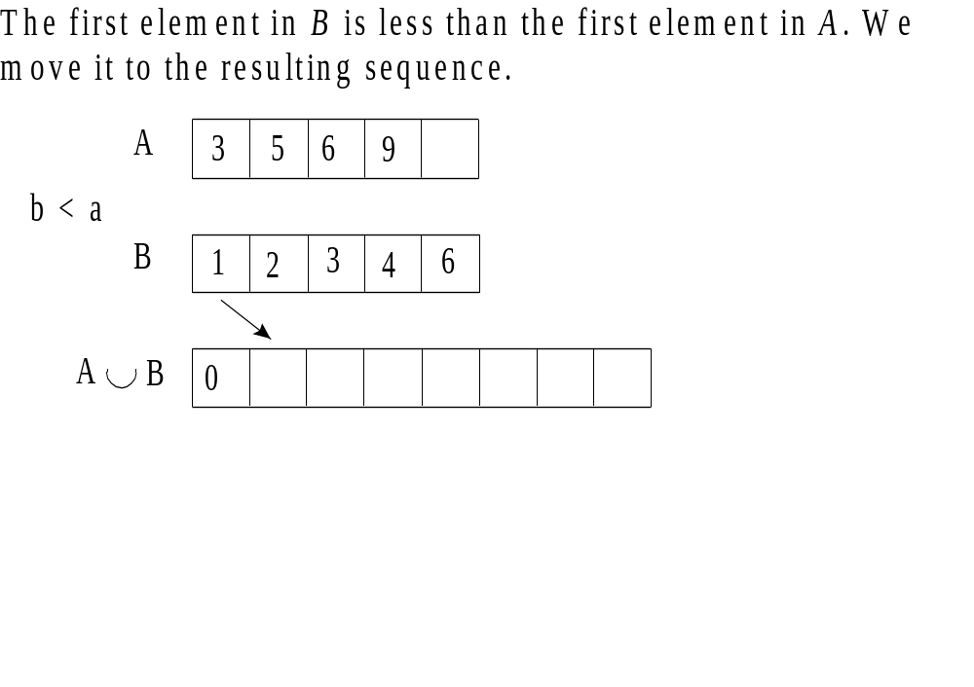

Slide 13
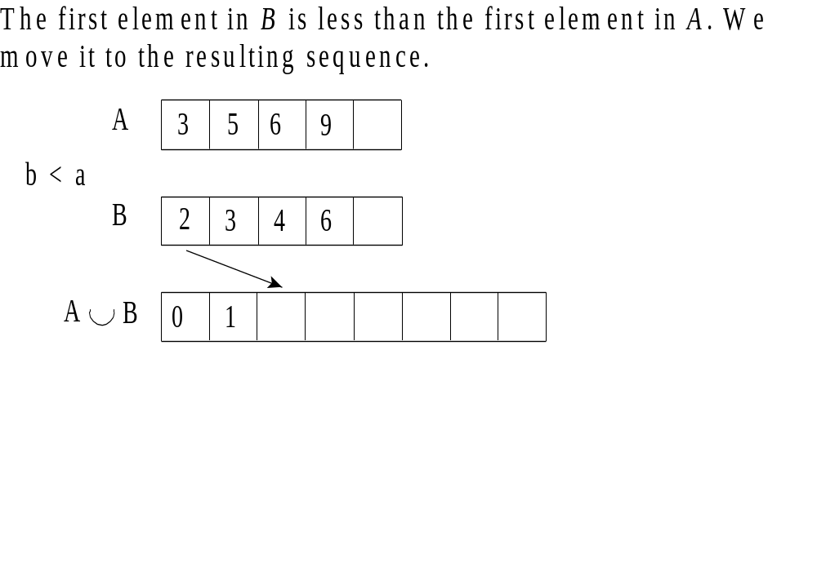

Slide 14
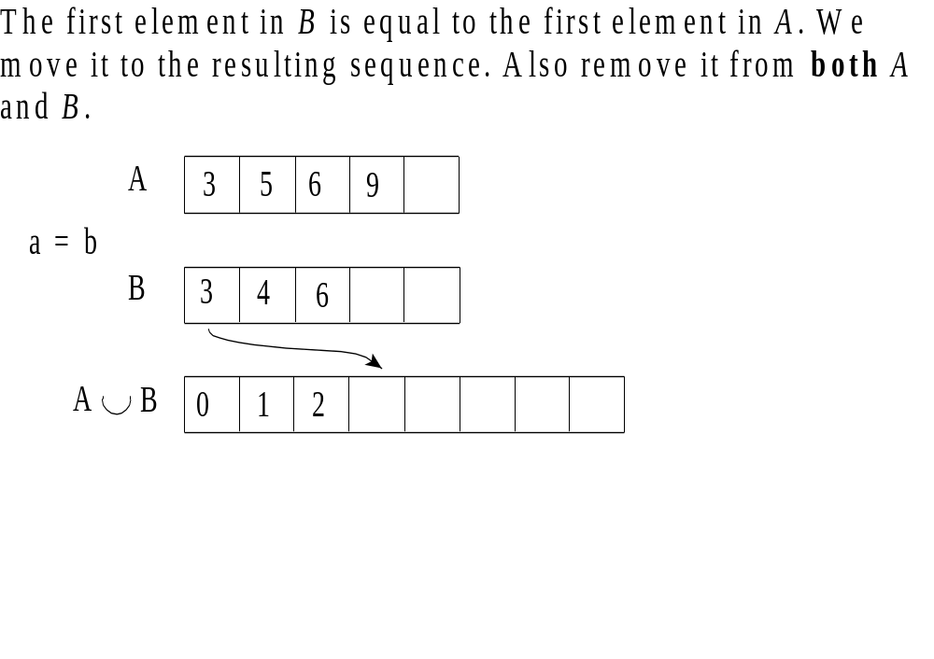

Slide 15
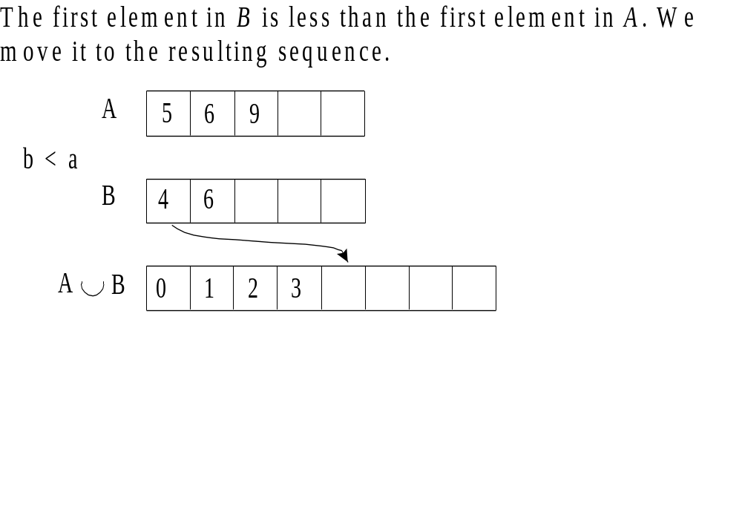

Slide 16
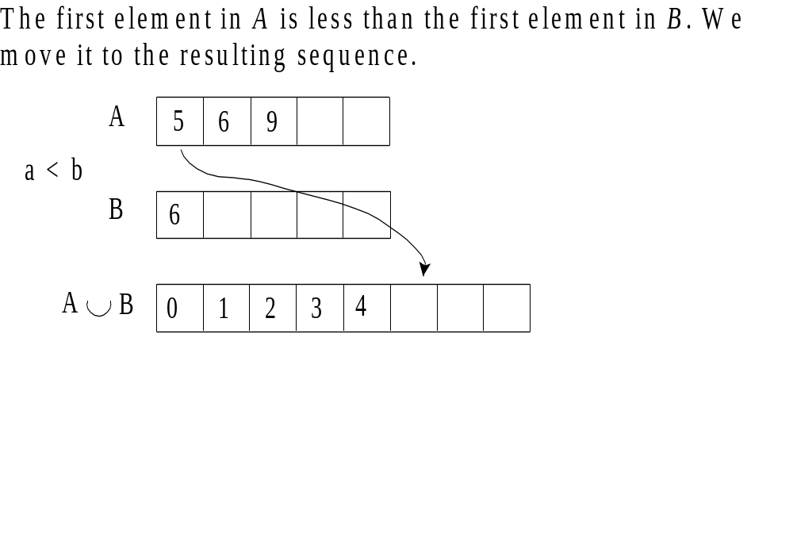

Slide 17
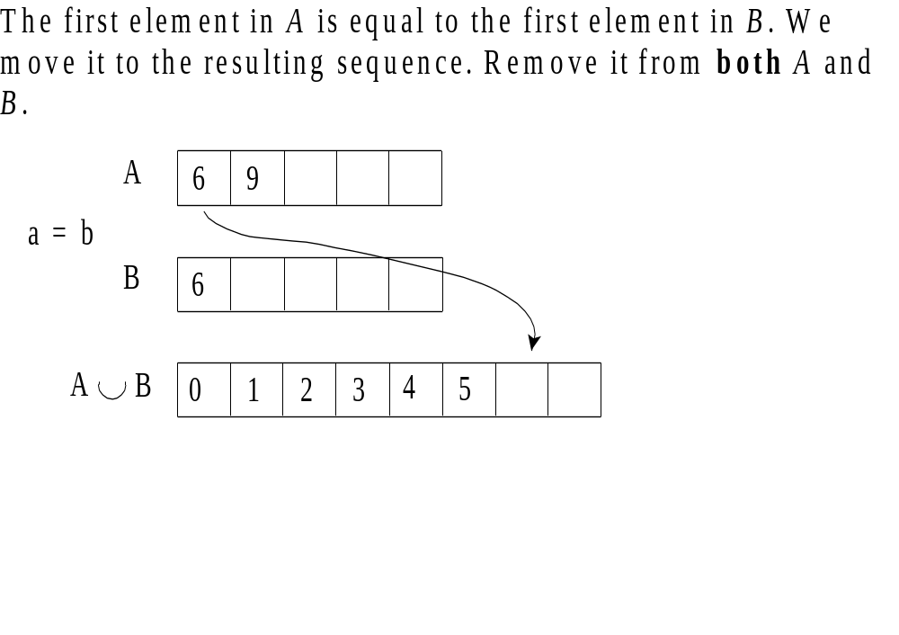

Slide 18
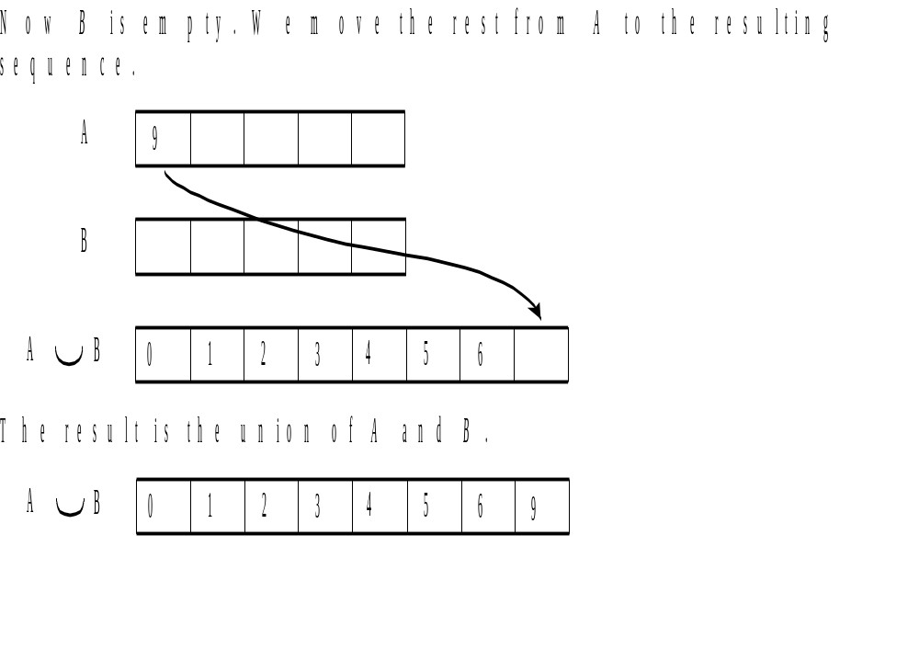

Slide 19
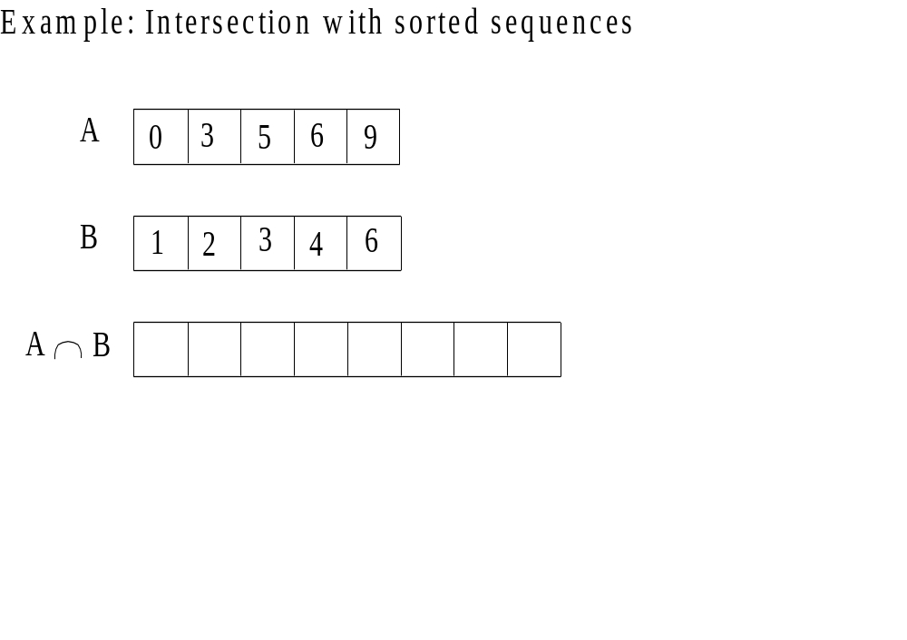

Slide 20
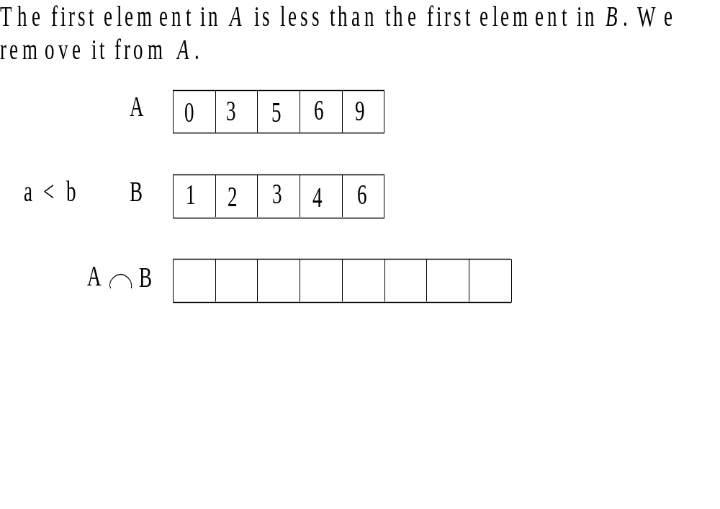

Slide 21
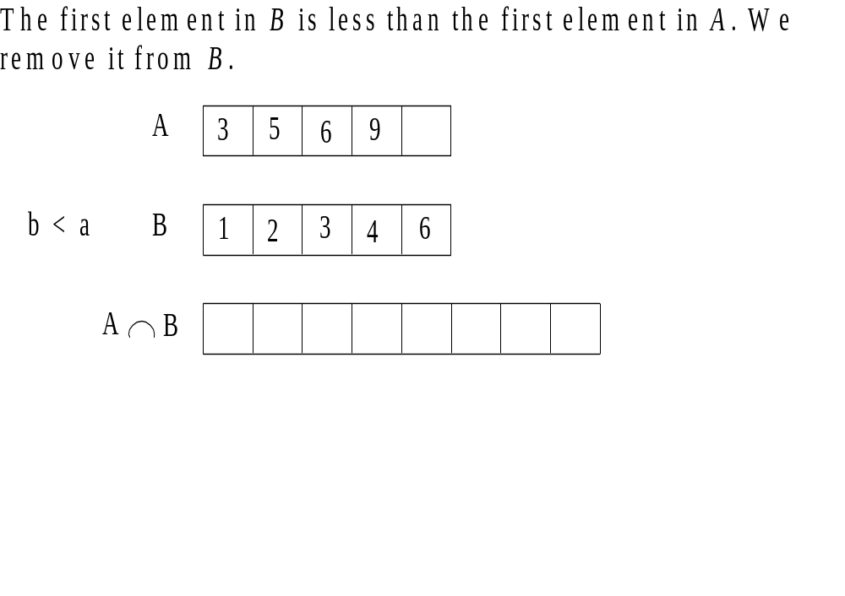

Slide 22
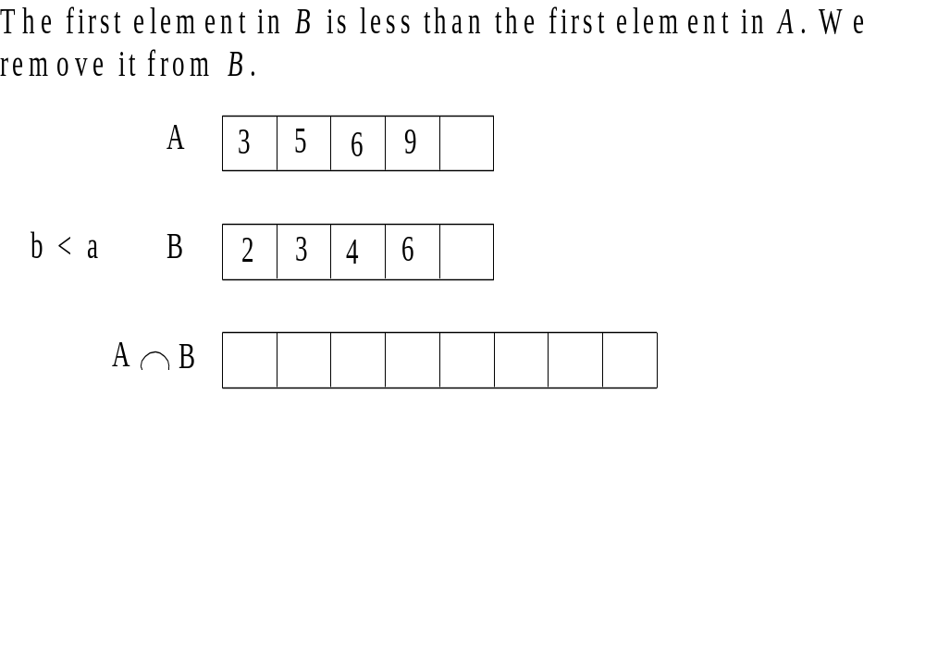

Slide 23
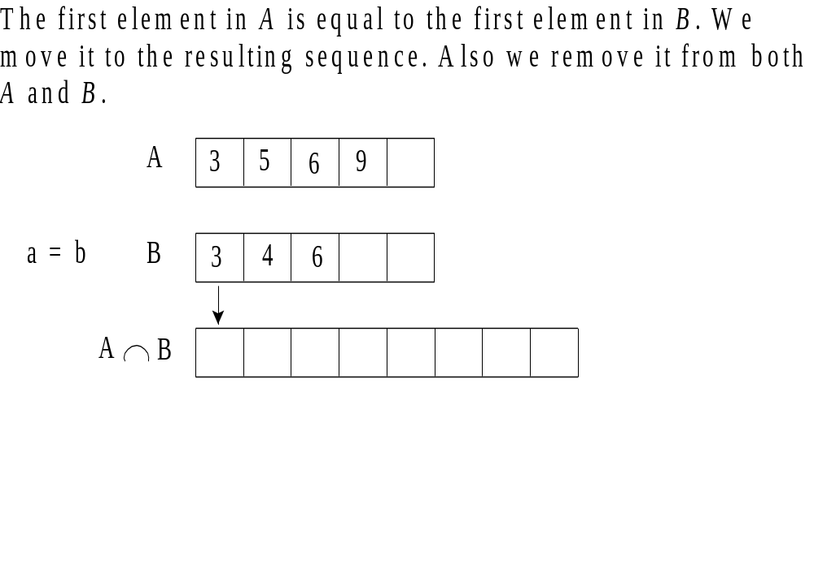

Slide 24
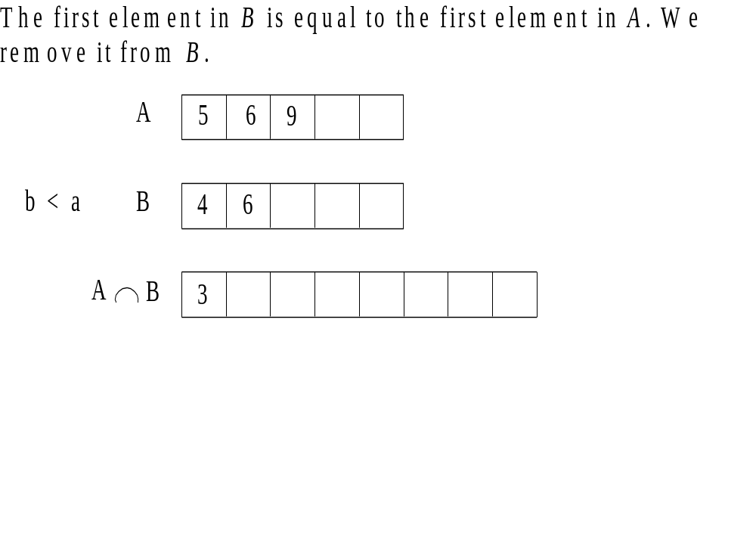

Slide 25
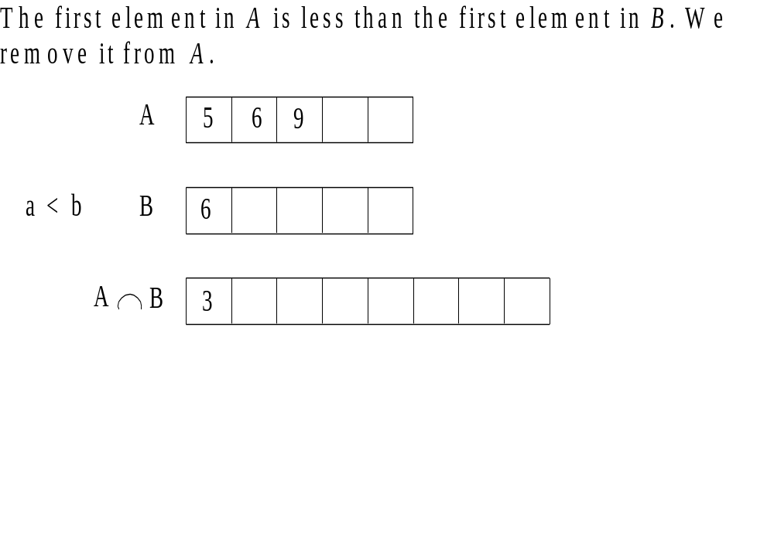

Slide 26
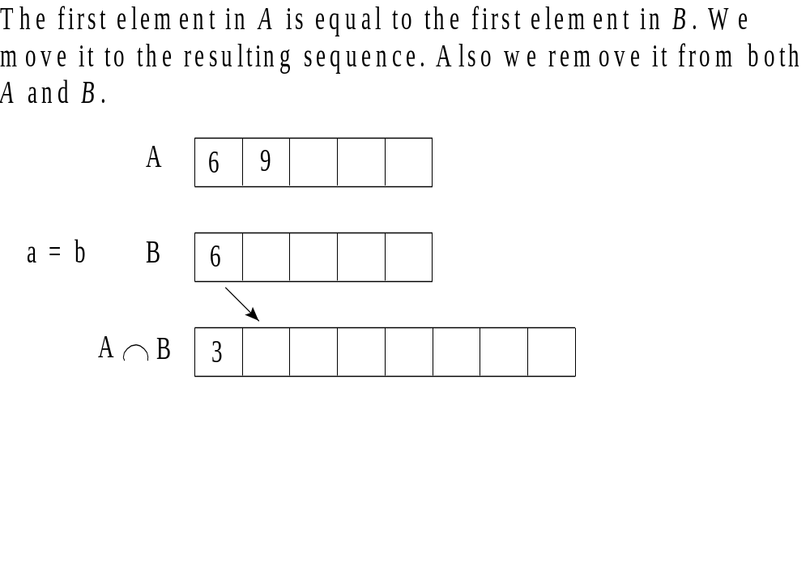

Slide 27
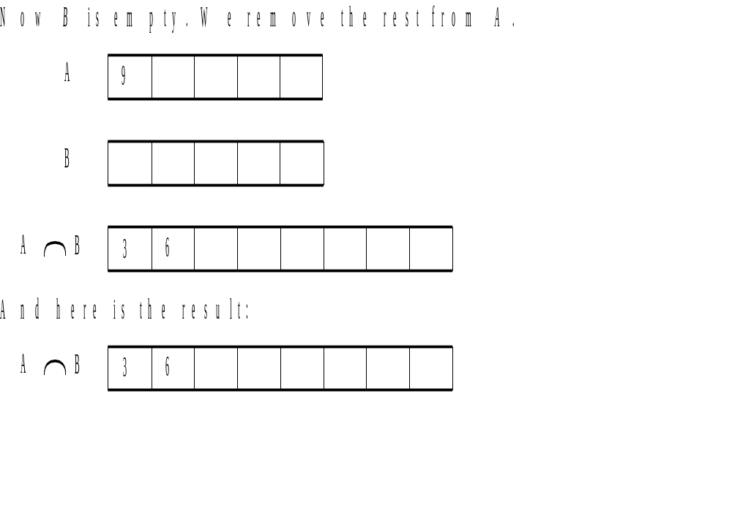

Slide 28
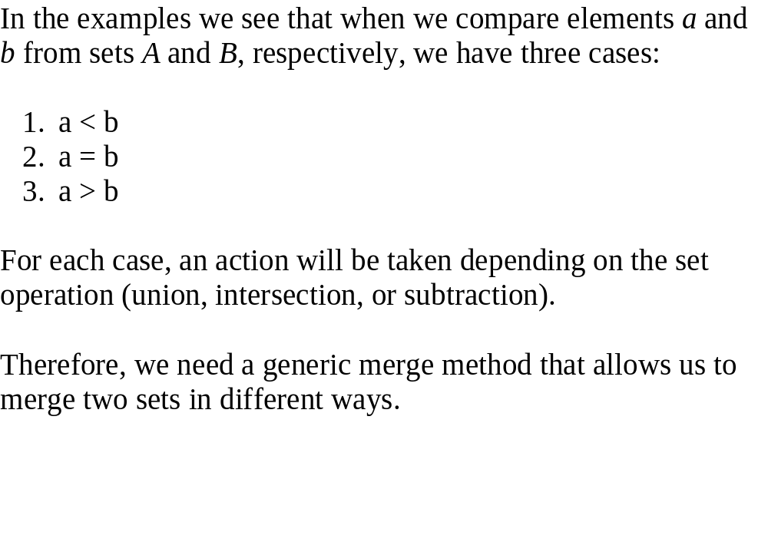

Slide 29
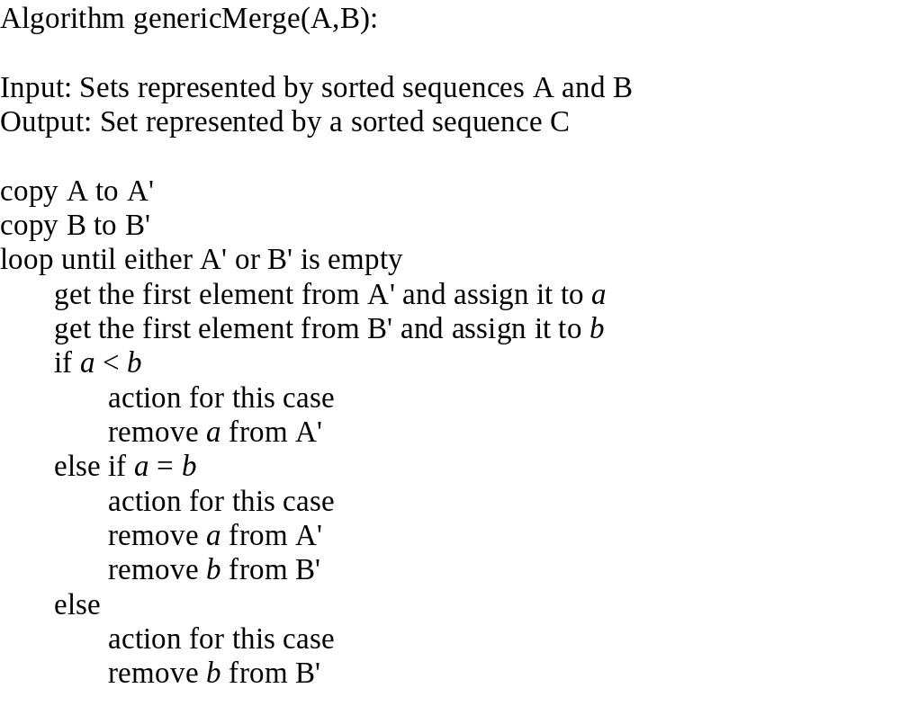

Slide 30
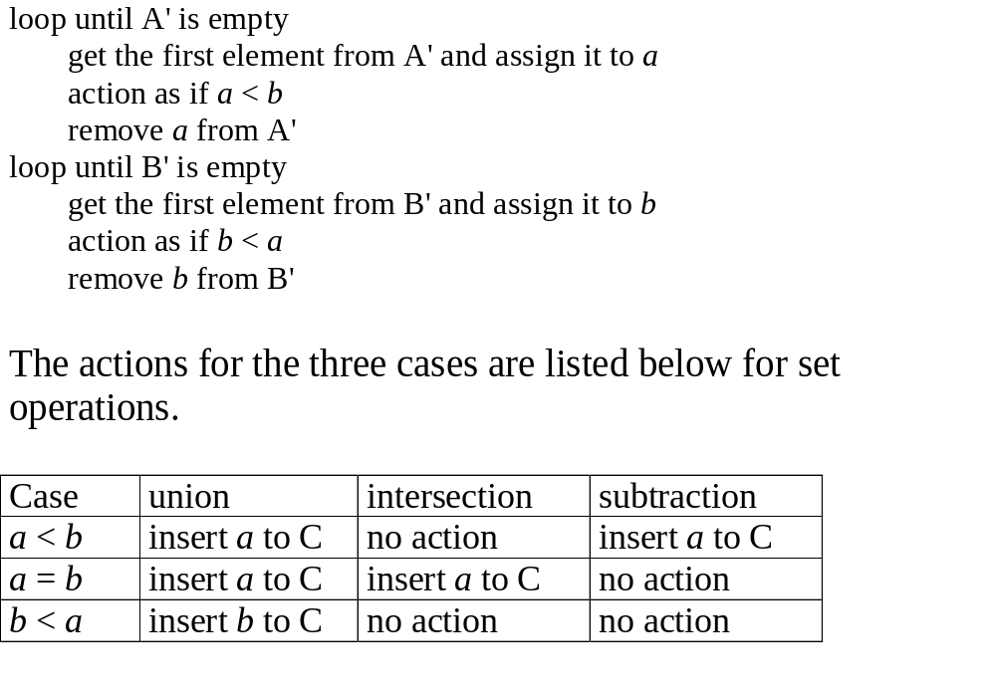

Slide 31
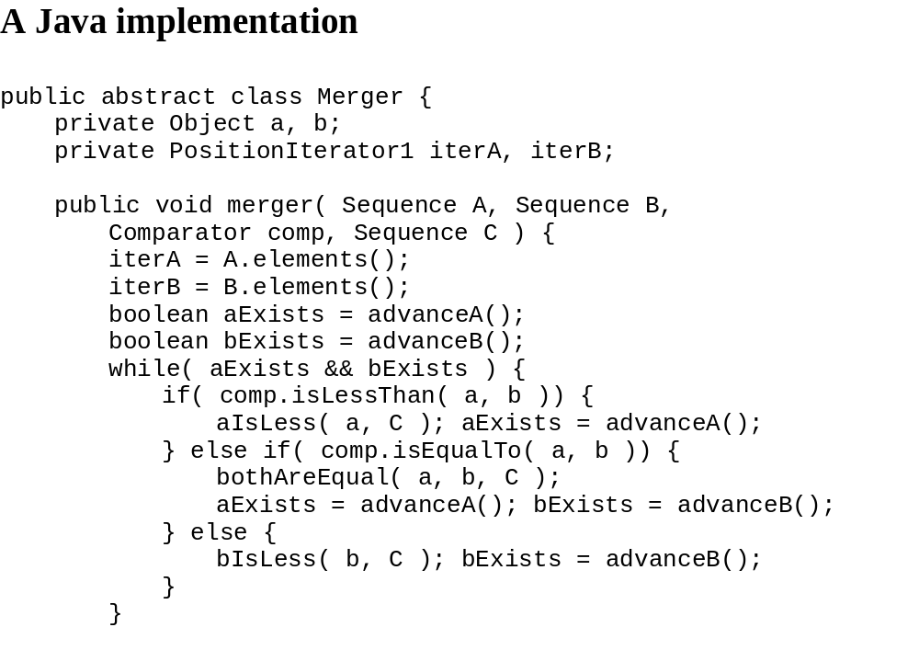

Slide 32
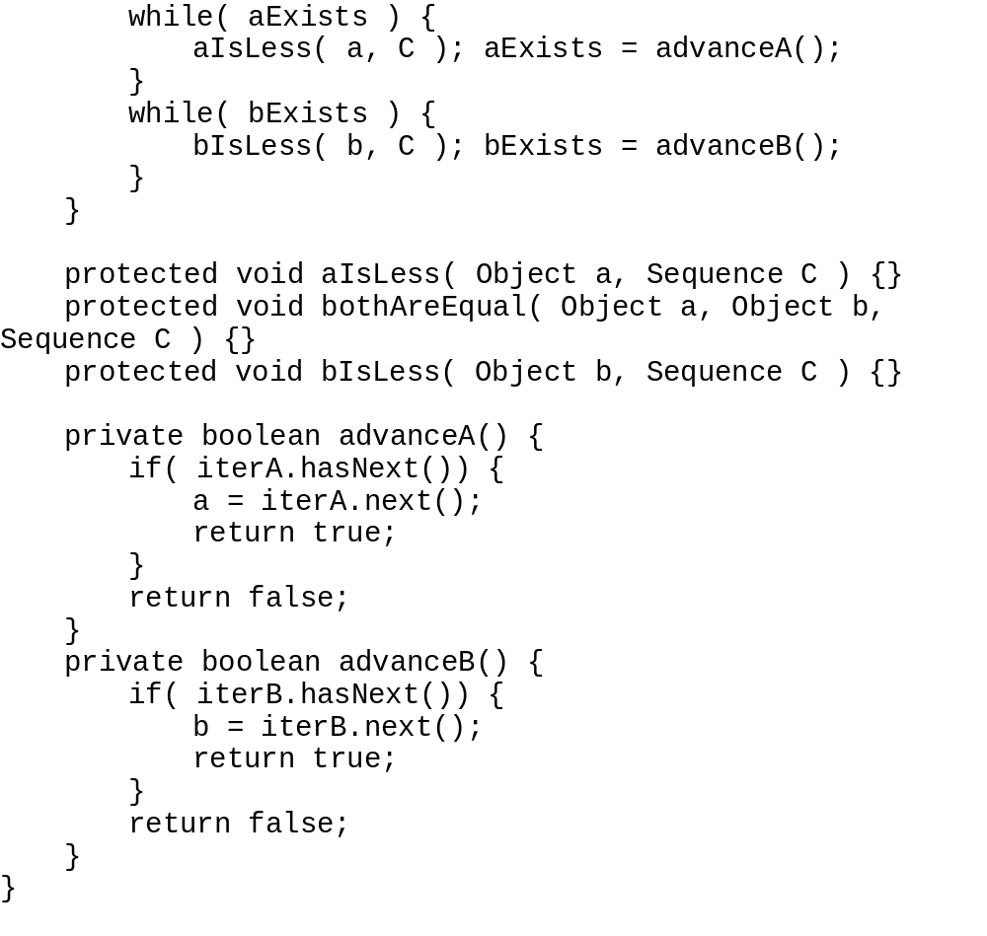
loop until A' is empty
get the first element from A' and assign
it to a
action as if a < b
remove a from A'
loop until B' is empty
get the first element from B'
and assign it to b
action as if b < a
remove b from B'

Slide 33
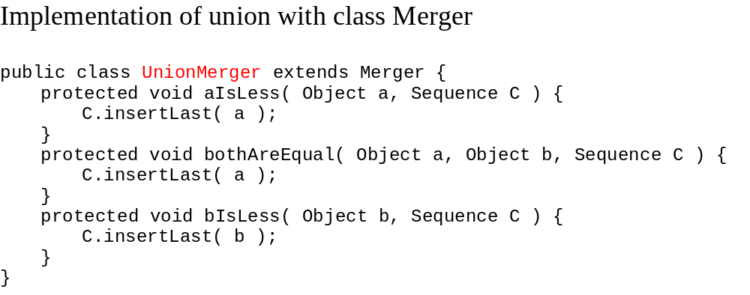
Case union
a < b insert a to C
a = b insert a to C
a > b insert b to C

Slide 34
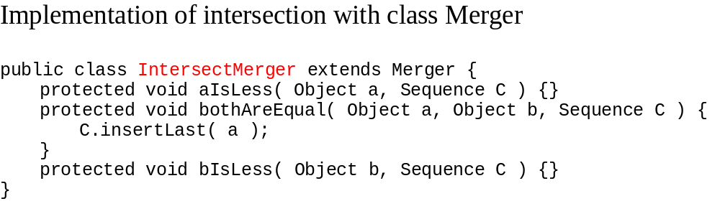
Case intersection
a < b no action
a = b insert a to C
a > b no action

Slide 35
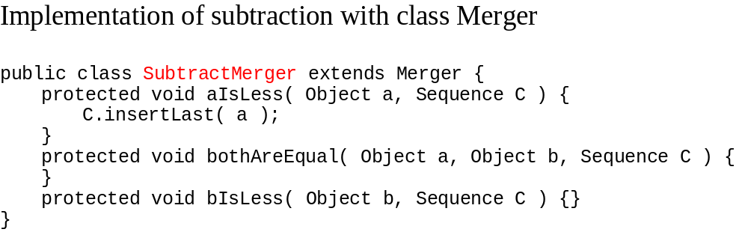
Case subtraction
a < b insert a to C
a = b no action
a > b no action

Slide 36
public class SetOperations {
public static void main (String[] args) {
NodeSequence a = new NodeSequence();
NodeSequence b = new NodeSequence();
int i = 0;
int j[] = {1, 2, 3, 4, 5, 4, 5, 6, 7, 8};
Position p = a.insertFirst(new Integer(j[0]));
for(i = 0; i < 4; i++)
{Integer k = new Integer(j[i+1]);
p = a.insertAfter(p, k);
}
System.out.print("set1: {");
p = a.first();
for (i = 0; i < 5; i++) {
try {
System.out.print(((Integer)(p.element())).intValue()
+ " ");
p = a.next(p); }

Slide 37
catch(BoundaryViolationException e) {break;}
}
System.out.print("}");
System.out.println('\n');
p = b.insertFirst(new Integer(j[5]));
for(i = 5; i < 9; i++)
{Integer k = new Integer(j[i+1]);
p = b.insertAfter(p, k);
}
System.out.print("set2: {");
p = b.first();
for (i = 0; i < 5; i++) {
try{
System.out.print(((Integer)(p.element())).intValue()
+ " ");
p = b.next(p);}
catch(BoundaryViolationException e) {break;}
}

Slide 38
System.out.print("}");
System.out.println('\n');
Comparator c = new Comparator();
NodeSequence s1 = new NodeSequence();
UnionMerger u1 = new UnionMerger();
u1.merger(a, b, c, s1);
System.out.print("Union of sets: {");
p = s1.first();
for (i = 0; i < 10; i++) {
try{
System.out.print(((Integer)(p.element())).intValue()
+ " ");
p = s1.next(p);
}
catch(BoundaryViolationException e) {break;}}
System.out.print("}");
System.out.println('\n');

Slide 39
IntersectMerger u2 = new IntersectMerger();
NodeSequence s2 = new NodeSequence();
u2.merger(a, b, c, s2);
System.out.print("Intersection of sets: {");
p = s2.first();
for (i = 0; i < 10; i++) {
try{
System.out.print(((Integer)(p.element())).intValue()
+ " ");
p = s2.next(p);
}
catch(BoundaryViolationException e) {break;}
}
System.out.print("}");
System.out.println('\n');

Slide 40
SubtractMerger u3 = new SubtractMerger();
NodeSequence s3 = new NodeSequence();
u3.merger(a, b, c, s3);
System.out.print("Difference of sets: {");
p = s3.first();
for (i = 0; i < 10; i++) {
try{
System.out.print(((Integer)(p.element())).intValue()
+ " ");
p = s3.next(p);
}
catch(BoundaryViolationException e) {break;}
}
System.out.print("}");
System.out.println('\n');
}
}

Slide 41
Data Structure Exercises 18.1

